Slide 1
Rootkits

Slide 2
Agenda
Introduction
Definition of a Rootkit
Existing Methodologies to Detect Rootkits
Lrk4
Knark
Conclusion

Slide 3
Introduction
Current Vulnerabilities on the Internet
Current Techniques Used by System Administrators to monitor the status of Systems
  Intrusion Detection Systems
  File Integrity Programs
  Signature Analysis Programs

Slide 4
Agenda
Introduction
Definition of a Rootkit
Existing Methodologies to Detect Rootkits
Lrk4
Knark
Conclusion

Slide 5
Definition of a Rootkit
“Trojan Horse” into a Computer System
Malicious Programs that pretend to be normal programs
May also be programs:
  that masquerade as “possible” programs
  with names that approximate existing program
  already running and not easily identifiable by user

Slide 6
Definition of a Rootkit
Installing a Rootkit on a Target System
  Hacker MUST already have root level access on target system
  Gain root level access by compromising system via buffer overflow, password attack, social engineering
  Rootkit allows hacker to get back onto system with root level privilege

Slide 7
Definition of a Rootkit
Rootkits are a recent phenomenon
Developed by hackers to conceal their activities
One method is to replace existing binary system files that continue to function as normal but allow hacker back door access
Can be developed by skilled hacker with programming expertise

Slide 8
Agenda
Introduction
Definition of a Rootkit
Existing Methodologies to Detect Rootkits
Lrk4
Knark
Conclusion

Slide 9
Existing Methodologies to Detect Rootkits
Use of Host Based Intrusion Detection System (IDS)
  TRIPWIRE
  Advanced Intrusion Detection Environment (AIDE)
  Downloadable on Internet
    http://www.cs.tut.fi/~rammer/aide.html.
Chkrootkit
  chkrootkit is available at: http://www.chkrootkit.org

Slide 10
Existing Methodologies to Detect Rootkits
AIDE
  Open Source Product
  Can support multiple Integrity Checking Algorithms
Customized Configuration File (aide.conf) is necessary

Slide 11
Detecting a rootkit using AIDE
AIDE is a program that detects rootkits based on the checksums of the binary files
As can be seen from the following screen shot, AIDE detected that the netstat and login files have been changed by looking at their checksums
chsh, chfn, and passwd were not detected because they were not in this directory
Once this was done, another tool was used to detect rootkit -- chkrootkit

Slide 12
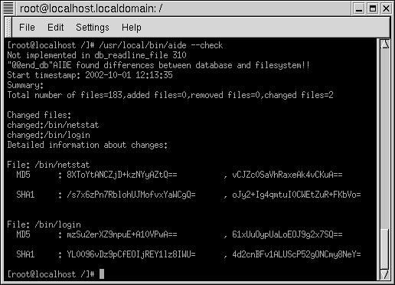
Detecting a rootkit using AIDE

Slide 13
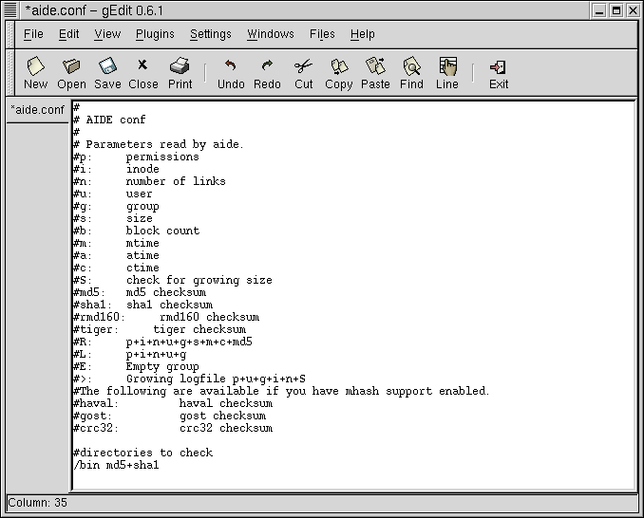

Slide 14
Detecting Rootkit with chkrootkit
This is simply a script file that can be used to detect the presence of rootkits based on certain signatures
For example, by detecting the string “root” in the login file, chkrootkit recognizes that the system has been compromised since the original login file did not have those strings in it
Show in the following screenshot are the results of running the chkrootkit program

Slide 15
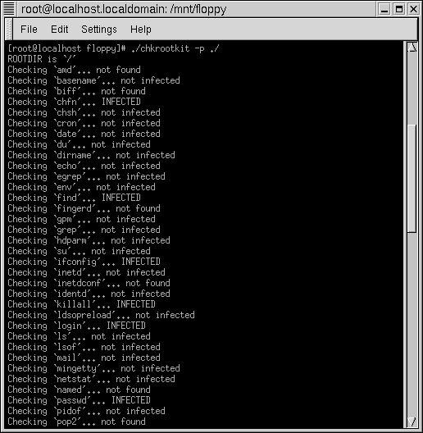
chkrootkit

Slide 16
Existing Methodologies to Detect Rootkits
Georgia Tech OIT Methodology to detect Rootkit Exploits
  30k-35k networked computers on campus
  Average data throughput 600Mbps/4 terabytes per day
  NO FIREWALL BETWEEN CAMPUS & INTERNET!
    Why? Requirement for Academic Freedom, high throughput
    However, individual enclaves within Georgia Tech use firewalls
  IDS is run at campus gateway
    Out of band monitoring and follow-on investigation

Slide 17
Existing Methodologies to Detect Rootkits
Installation of IDS
  Prior to installation – 5 investigations per week
  After installation – up to 5 investigations per day
Anomaly Based IDS monitors machines on campus
A Honeynet is currently running at Georgia Tech

Slide 18
Existing Methodologies to Detect Rootkits
Steps taken upon investigation of a compromised system:
  Contact responsible system administrator
  System may be rebooted with known good media with suspect hard drive mounted read-only
  Duplicate copy of hard drive may be produced with cryptographic checksum signature for possible criminal investigation

Slide 19
Existing Methodologies to Detect Rootkits
Forensic Investigation of compromised system:
  No formalized methodology currently exists for forensic investigation
  Logs will be examined first
    May have no record of exploit or may be deleted entirely
    Steps may be taken to retrieve deleted log files

Slide 20
Existing Methodologies to Detect Rootkits
Previously know target directories will be examined for suspicious files or entries
  eg. t0rn rootkit creates /etc/ttyhash which is a copy of the original /bin/login progam
chkrootkit program may be run to check for previously known exploits
  chkrootkit is available at: http://www.chkrootkit.org

Slide 21
Existing Methodologies to Detect Rootkits
For LINUX/UNIX systems various commands will be used to check for compromises:
  find & locate to look for suspicious files and directories
  file & strings to examine suspect files
  ldd (load library dependencies) & strace
Similar methodology used for other operating systems

Slide 22
Agenda
Introduction
Definition of a Rootkit
Existing Methodologies to Detect Rootkits
Lrk4
Knark
Conclusion

Slide 23
Lrk4 Background
Written by Lord Somer
Released in November 1998
Several more recent versions are available (lrk5 and lrk6); however, lrk4 is the most stable out of all of them
Updates for lrk4 still being posted
However, to run lrk4, it is necessary to install old libraries since lrk4 was built against these earlier libraries

Slide 24
Installing lrk4
Although a Makefile is included with lrk4, compilation results in several errors
  This is due to uniqueness of each operating system
  For this lab, red Hat 7.2 is used
  One major problem – numerous references to pre-defined library functions
  Other problems
    Failure to reference necessary libraries
    Failure to define referenced variables
Getting the rootkit to work requires some knowledge of programming

Slide 25
What does lrk4 change?
The following binaries are changed by lrk4:
  login – this signs a user onto the system
  chfn – used to change finger information
  chsh – used to change login shell
  passwd – updates a user’s authentication token
Important change – hacker can now log onto system using the name “rewt” and password “satori”
To learn more about the changes, view the README file

Slide 26
Hiding lrk4 on the system
How do you make sure you’re changed binaries are not easily detected?
Run “fix” tool (normally comes with the rootkit)
  This changes the date of the binaries so that it looks like they are old binaries

Slide 27
Detecting lrk4
The “fix” tool has a bug – it changes the date of the binary but not the size
Any file integrity software (such as Tripwire) will catch the change in binary sizes
ldd command can be used to see what libraries a binary links to – this can also be used to detect a corrupted binary
The following screenshot shows the output from running the ldd command against the normal login and the corrupted login

Slide 28
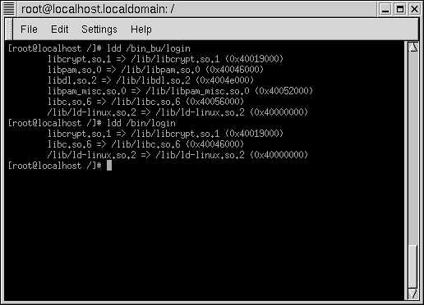
Detecting lrk4

Slide 29
Detecting lrk4
As can be seen, the corrupted login only links to three libraries while the normal login links to six libraries – a clear indication that the binary has been changed
Notice that the corrupted login does not use the Password Authentication Module (PAM)
  Instead, Shadow-suite software is used
  Hence, no link to the PAM library
  Availability of a rpm for Shadow Suite is probably why it was used instead of PAM for the corrupted login – otherwise the PAM module would have to be modified

Slide 30
Lrk4 Code
Running the diff command on the two login files reveals some noticeable differences:
  Integer variable “elite”
  Five character array “rewt”
Character array stores the name “rewt” and a terminating null character, as shown in the next screenshot
If another character array had been used for the comparison, the string “root” would never have been detected

Slide 31
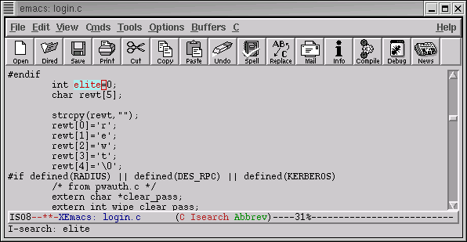
Lrk4 Code – “Rewt”

Slide 32
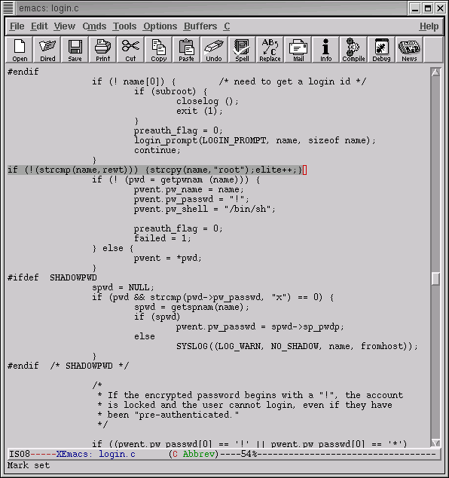
Lrk4 Code
The following code allows for the hacker to gain root access with the username “rewt”

Slide 33
Lrk4 Code – Trojan Password
Ok, so we have root being passed in … what about the password?
  pw_auth program check’s to see if a user’s password is valid
  pw_auth code is modified so that trojan password “satori” is added to password list
  Trojan password stored in a seven character array and values copied from rootkit.h header file

Slide 34
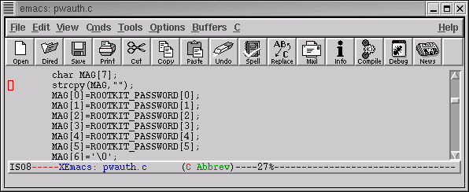
Lrk4 Code – Trojan Password

Slide 35
Lrk4 Code – Trojan Password
  Clean pw_auth would return value of ‘0’ whenever password validated
  Edited pw_auth returns value of ‘3’ when input password matches password in rootkit.h
  Program then transitions to the auth_ok portion of login.c
  Elite variable is set to ‘1’
    Significant for remainder of login.c program

Slide 36
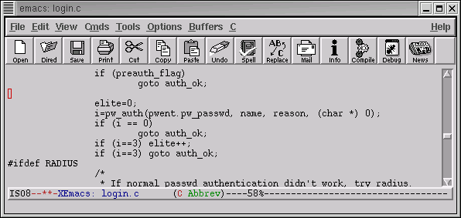
Lrk4 Code – Trojan Password

Slide 37
Lrk4 Code – Logging Events
So we’ve gained access to the machine … how can we make sure our activities aren’t logged?
  Check to see if the user has entered the trojan password and username “rewt”
  If so, then bypass logging activities to the SYSLOG file
  This is accomplished with the following code fragment:

Slide 38
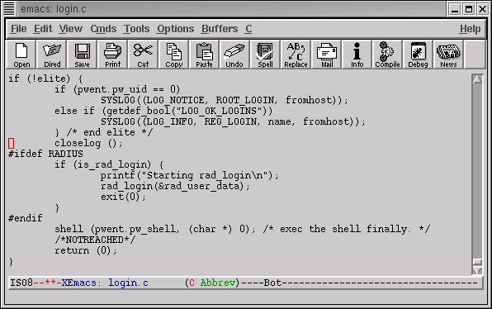
Lrk4 Code – Logging Events

Slide 39
Lrk4 Summary
Lrk4 is a very powerful tool
Trojan username and password can be used to gain root access on a system
Not easy to get lrk4 to work sometimes – requires a degree of programming skill
Tracks can be covered to a certain extent – however, file integrity systems will still detect that a rootkit has been installed

Slide 40
Agenda
Introduction
Definition of a Rootkit
Existing Methodologies to Detect Rootkits
Lrk4
Knark
Conclusion

Slide 41
KNARK Background
Written by Creed
Released in 1999
Versions exist for Linux 2.2 and 2.4 kernels
Very popular in ‘script kiddie’ community

Slide 42
KNARK Capabilities
Hide/Unhide files or directories
Hide TCP/UDP connections
Execution Redirection
Unauthenticated privilege escalation via the rootme program within knark
Ability to change UID/GID of a running process
Unauthenticated, privileged remote execution daemon
Kill –31 to hide a running process

Slide 43
Installing KNARK
KNARK IS installed as a Loadable Kernel Module (LKM)
  System must have LKM enabled in order to be able to load KNARK
  Can be defeated if LKM is disabled, HOWEVER, updating system becomes much more complicated
The KNARK rootkit has an additional LKM module to hide the presence of KNARK from the insmod (installed module) command.

Slide 44
What does KNARK Change?
KNARK modifies the system call table (sys_call_table) within kernel memory by redirecting some system calls (sys_read, sys_getdents) to malicous system calls written by CREED.
These new malicious system calls function as normal except in certain circumstances.

Slide 45
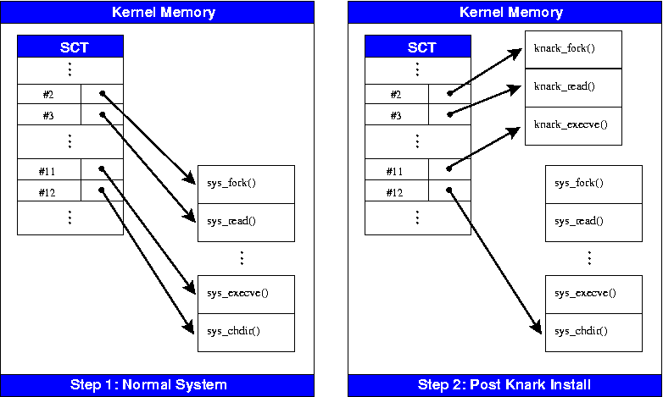
What does KNARK change?

Slide 46
What does KNARK Change?
Can no longer trust the output of the system calls?
Very difficult to detect rootkits such as KNARK using conventional methods
  System utility files (ls, ps) are not modified
  Kernel Output to system utility files IS modified.

Slide 47
Detecting KNARK
Cyptographic Checksums of system utilities will NOT change when KNARK is installed
  May be possible to take cryptographic checksum of selected region of kernel in order to detect rootkit modification of kernel (StMichael)
Can detect presence of KNARK type rootkits by examining sys_call_table

Slide 48
Detecting KNARK
The file /boot/System.map is created when system is initially compiled
  /boot/System.map contains correct address of kernel system calls
  /boot/system map can be archived or retrieved from a known good system for comparison
Must have Superuser (ROOT) privilege in order to read /dev/kmem (kernel memory)

Slide 49
Detecting KNARK using the kern_check program
Developed by Samhain labs
GPL (‘free’) software
Compares /boot/System.map file against the system call table in kernel memory
Will not work against later versions of Red Hat Linux 2.4 or the Linux 2.6 kernel

Slide 50
KNARK Summary
KNARK is a very powerful tool that was very popular with ‘script kiddies’
Very difficult to detect with conventional methods
Can no longer trust system output once kernel is compromised
Other kernel rootkits can defeat kern_check program (SuckIT)

Slide 51
Rootkit Summary
Prevent hackers from gaining root access in order to prevent rootkits from being installed
Must check systems on a periodic basis for rootkit exploits
Current advice for a rootkitted system: Wipe out files and re-install operating system.
Is it possible to re-establish trust on a Rootkited System?

